Slide 1

Faster and More Dynamic Maximum Flow by Incremental Breadth-First Search
Andrew V. Goldberg, Sagi Hed, Haim Kaplan, Pushmeet Kohli, Robert E. Tarjan, and Renato F. Werneck
Presenter: Chia-Che Li

Slide 2
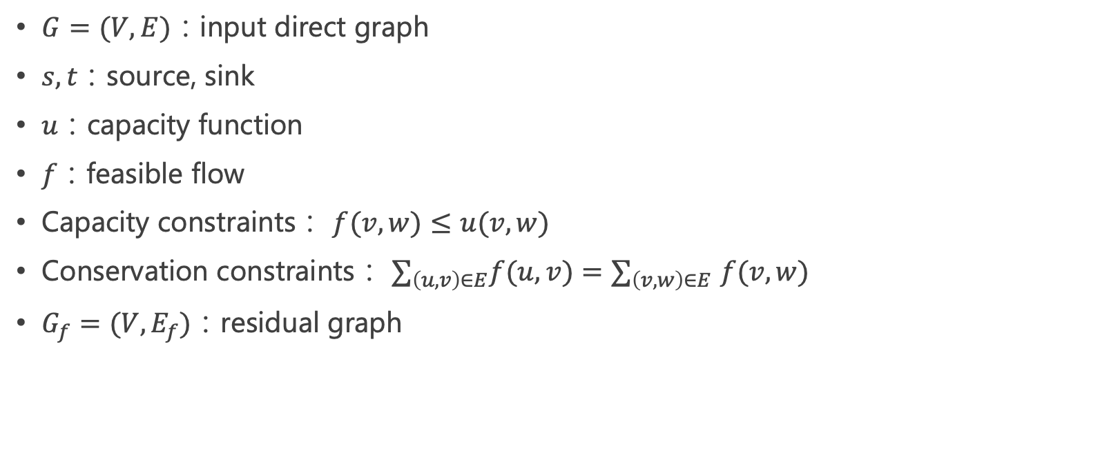
Notation (1/2)
$G=(V,E)$：input direct graph
$s,t：$source, sink
$u：$capacity function
$f：$feasible flow
Capacity constraints： $f(v,w)≤u(v,w)$
Conservation constraints： $∑_{\left(u,v\right)∈E}f(u,v)$ ${=∑}_{\left(v,w\right)∈E}f(v,w)$
$G_{f}=(V,E_{f})$：residual graph

Slide 3
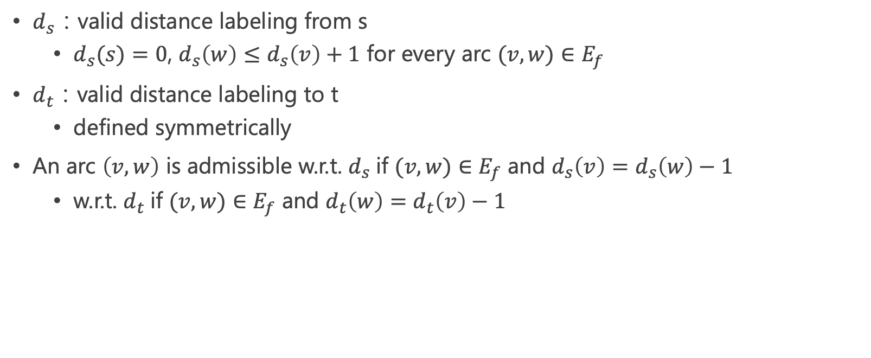
Notation (2/2)
$d_{s}$：valid distance labeling from s
$d_{s}(s)=0$, $d_{s}\left(w\right)≤d_{s}\left(v\right)+1$ for every arc $(v,w)∈E_{f}$
$d_{t}$：valid distance labeling to t
defined symmetrically
An arc $\left(v,w\right)$ is admissible w.r.t. $d_{s}$if $(v,w)∈E_{f}$ and $d_{s}\left(v\right)=d_{s}\left(w\right)−1$
w.r.t. $d_{t}$if $(v,w)∈E_{f}$ and $d_{t}\left(w\right)=d_{t}\left(v\right)−1$

Slide 4
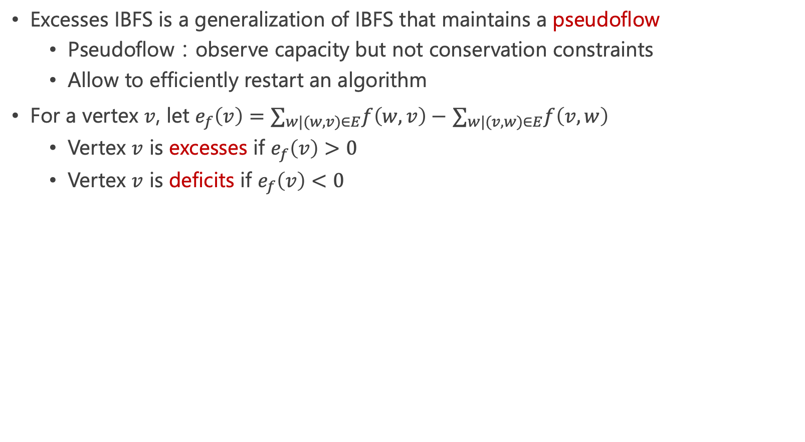
Excesses IBFS：Introduction (1/2)
Excesses IBFS is a generalization of IBFS that maintains a pseudoflow
Pseudoflow：observe capacity but not conservation constraints
Allow to efficiently restart an algorithm
For a vertex $v$, let $e_{f}\left(v\right)=∑_{w|(w,v)∈E}f\left(w,v\right)−$ $∑_{w|(v,w)∈E}f\left(v,w\right)$
Vertex $v$ is excesses if $e_{f}\left(v\right)>0$
Vertex $v$ is deficits if $e_{f}\left(v\right)<0$

Slide 5
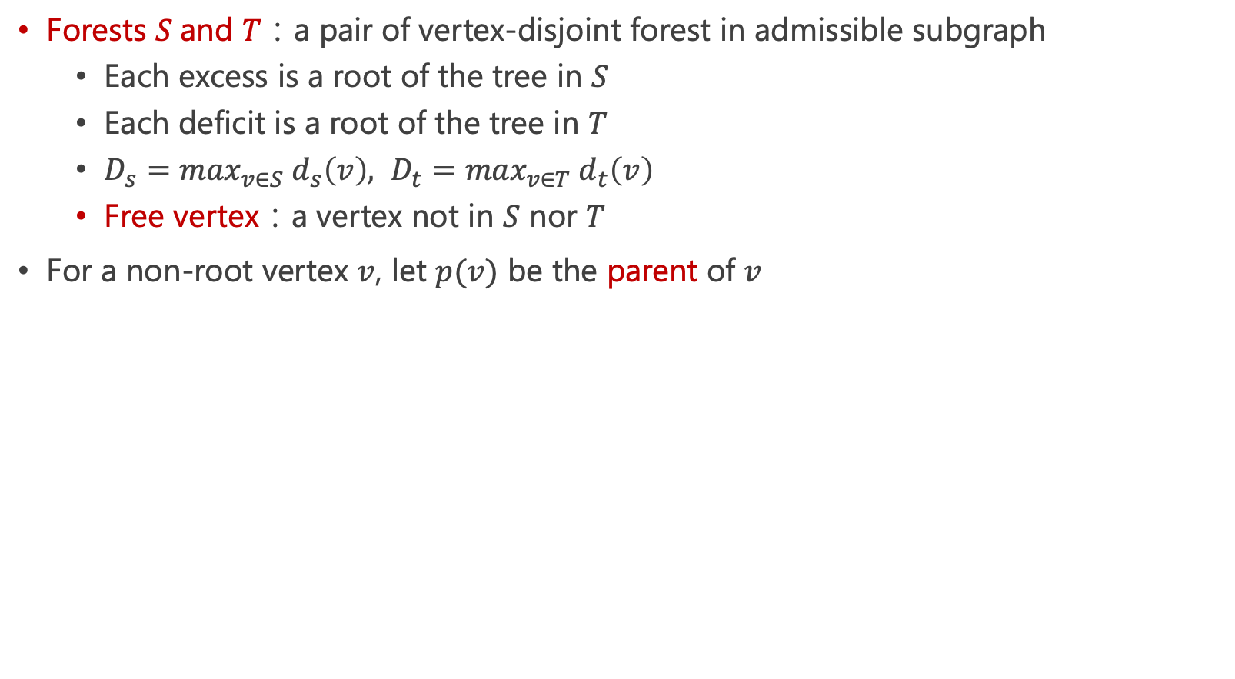
Excesses IBFS：Introduction (2/2)
Forests $S$and $T$：a pair of vertex-disjoint forest in admissible subgraph
Each excess is a root of the tree in $S$
Each deficit is a root of the tree in $T$
$D_{s}=\max_{v∈S} d_{s}\left(v\right), D_{t}=\max_{v∈T} d_{t}\left(v\right)$
Free vertex：a vertex not in $S$ nor $T$
For a non-root vertex $v$, let $p(v)$ be the parent of $v$

Slide 6
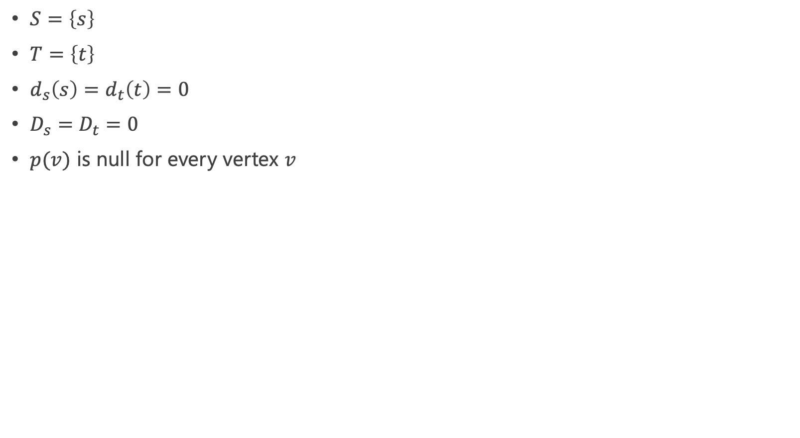
Excesses IBFS：Initialize
$S=\left\{s\right\}$
$T=\left\{t\right\}$
$d_{s}\left(s\right)=d_{t}\left(t\right)=0$
$D_{s}=D_{t}=0$
$p(v)$ is null for every vertex $v$

Slide 7
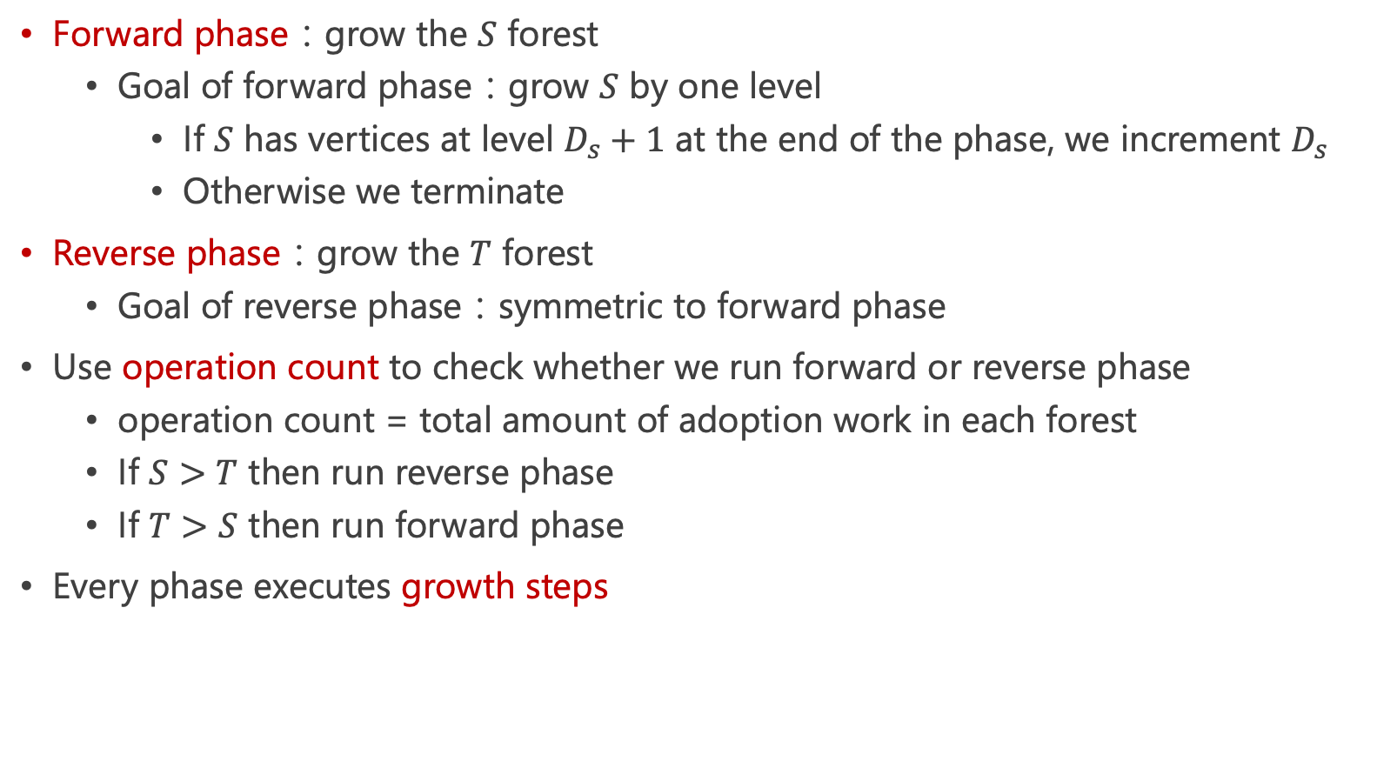
Forward and Reverse Phases
Forward phase：grow the $S$ forest
Goal of forward phase：grow $S$ by one level
If $S$ has vertices at level $D_{s}+1$ at the end of the phase, we increment $D_{s}$
Otherwise we terminate
Reverse phase：grow the $T$ forest
Goal of reverse phase：symmetric to forward phase
Use operation count to check whether we run forward or reverse phase
operation count = total amount of adoption work in each forest
If $S>T$ then run reverse phase
If $T>S$ then run forward phase
Every phase executes growth steps

Slide 8
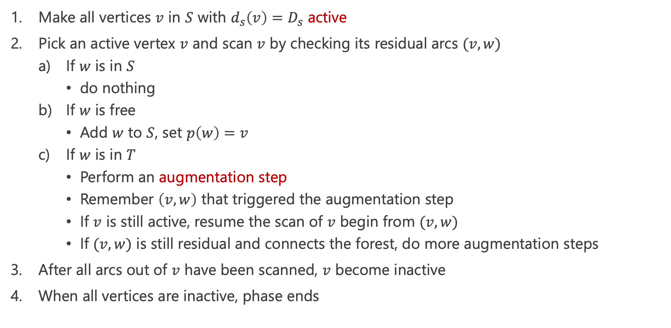
Growth Steps
Make all vertices $v$ in $S$ with $d_{s}\left(v\right)=D_{s}$ active
Pick an active vertex $v$ and scan $v$ by checking its residual arcs $(v,w)$
If $w$ is in $S$
do nothing
If $w$ is free
Add $w$ to $S$, set $p\left(w\right)=v$
If $w$ is in $T$
Perform an augmentation step
Remember $\left(v,w\right)$ that triggered the augmentation step
If $v$ is still active, resume the scan of $v$ begin from $(v,w)$
If $(v,w)$ is still residual and connects the forest, do more augmentation steps
After all arcs out of $v$ have been scanned, $v$ become inactive
When all vertices are inactive, phase ends

Slide 9
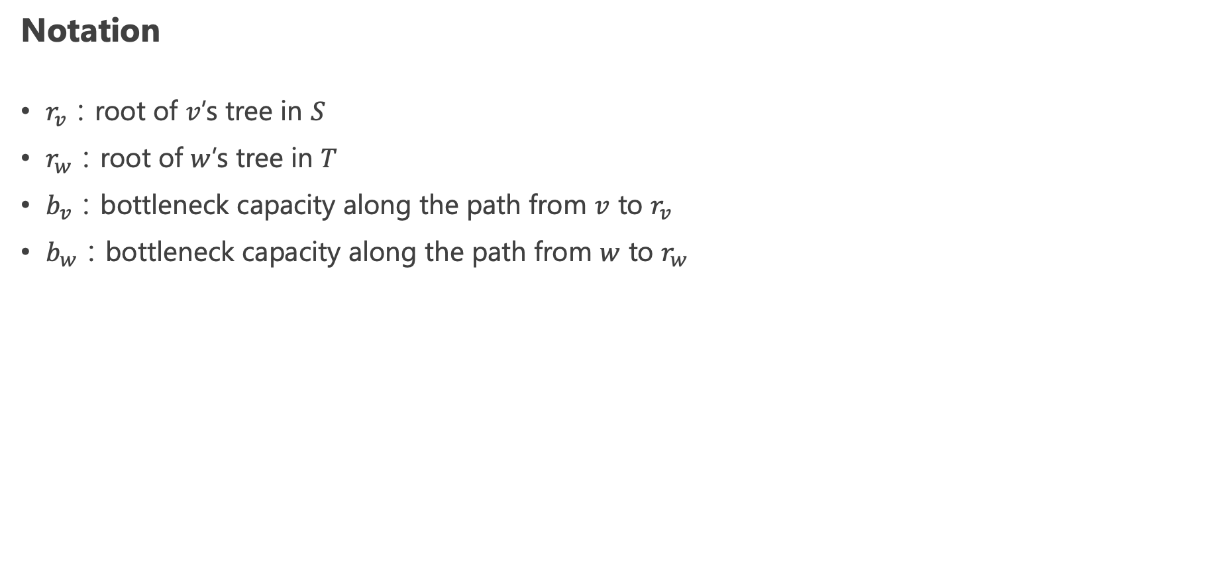
Augmentation Steps (1/2)
Notation
$r_{v}$：root of $v$’s tree in $S$
$r_{w}$：root of $w$’s tree in $T$
$b_{v}$：bottleneck capacity along the path from $v$ to $r_{v}$
$b_{w}$：bottleneck capacity along the path from $w$ to $r_{w}$

Slide 10
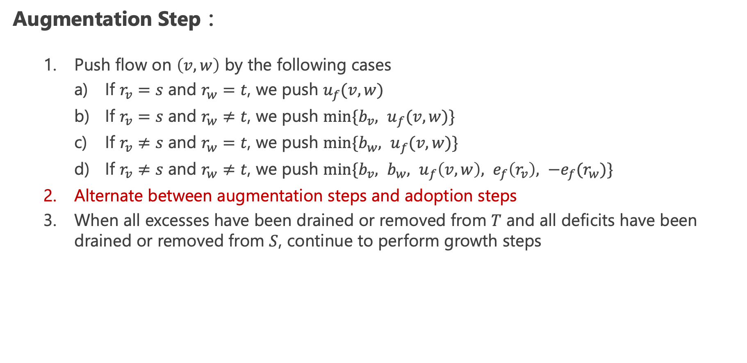
Augmentation Steps (2/2)
Augmentation Step：
Push flow on $\left(v,w\right)$ by the following cases
If $r_{v}=s$ and $r_{w}=t$, we push $u_{f}(v,w)$
If $r_{v}=s$ and $r_{w}≠t$, we push ${min⁡\{b_{v}, u}_{f}(v,w)\}$
If $r_{v}≠s$ and $r_{w}=t$, we push ${min⁡\{b_{w}, u}_{f}(v,w)\}$
If $r_{v}≠s$ and $r_{w}≠t$, we push ${min⁡\{b_{v}, b_{w}, u}_{f}\left(v,w\right), e_{f}\left(r_{v}\right), −e_{f}(r_{w})\}$
Alternate between augmentation steps and adoption steps
When all excesses have been drained or removed from $T$ and all deficits have been drained or removed from $S$, continue to perform growth steps

Slide 11
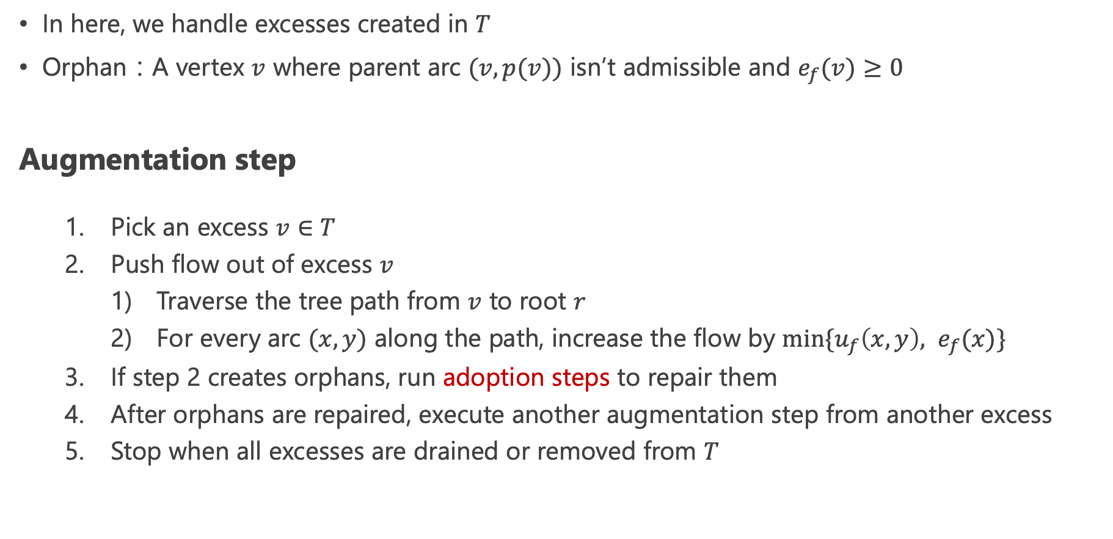
Alternate Between Augmentation Steps and Adoption Steps (1/2)
In here, we handle excesses created in $T$
Orphan：A vertex $v$ where parent arc $(v,p(v))$ isn’t admissible and $e_{f}(v)≥0$
Augmentation step
Pick an excess $v∈T$
Push flow out of excess $v$
Traverse the tree path from $v$ to root $r$
For every arc $(x,y)$ along the path, increase the flow by $min⁡\{u_{f}\left(x,y\right), e_{f}(x)\}$
If step 2 creates orphans, run adoption steps to repair them
After orphans are repaired, execute another augmentation step from another excess
Stop when all excesses are drained or removed from $T$

Slide 12
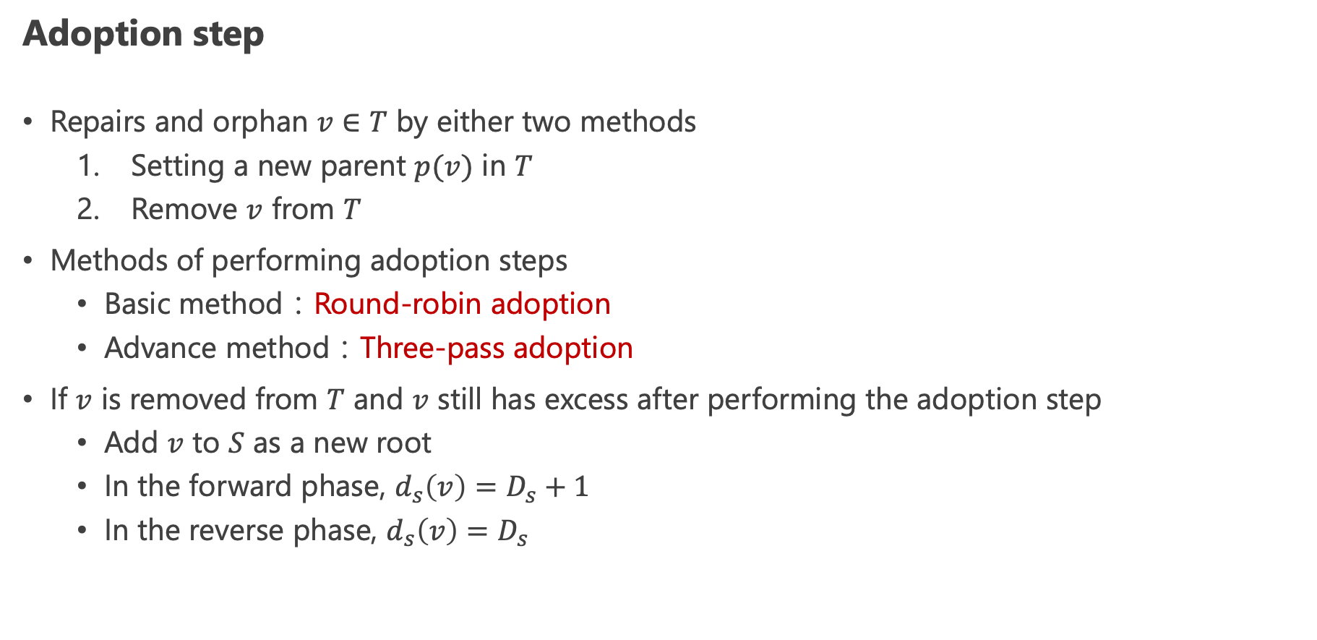
Alternate Between Augmentation Steps and Adoption Steps (2/2)
Adoption step
Repairs and orphan $v∈T$ by either two methods
Setting a new parent $p(v)$ in $T$
Remove $v$ from $T$
Methods of performing adoption steps
Basic method：Round-robin adoption
Advance method：Three-pass adoption
If $v$ is removed from $T$ and $v$ still has excess after performing the adoption step
Add $v$ to $S$ as a new root
In the forward phase, $d_{s}\left(v\right)=D_{s}+1$
In the reverse phase, $d_{s}\left(v\right)=D_{s}$

Slide 13
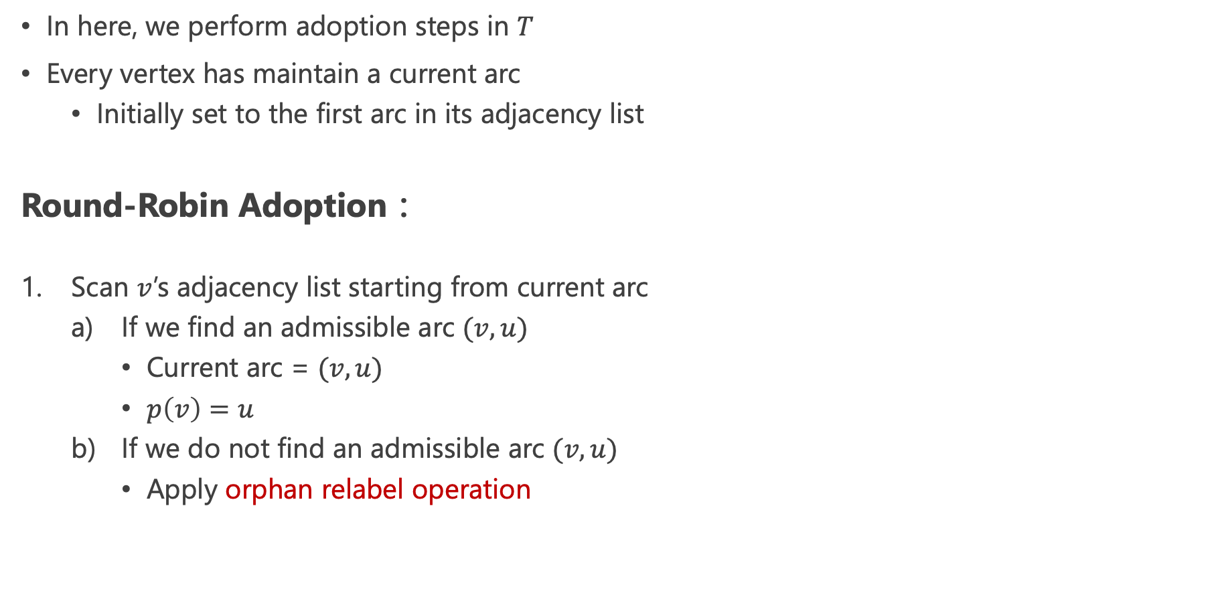
Adoption Steps：Round-Robin Adoption
In here, we perform adoption steps in $T$
Every vertex has maintain a current arc
Initially set to the first arc in its adjacency list
Round-Robin Adoption：
Scan $v$’s adjacency list starting from current arc
If we find an admissible arc $(v,u)$
Current arc = $(v,u)$
$p\left(v\right)=u$
If we do not find an admissible arc $(v,u)$
Apply orphan relabel operation

Slide 14
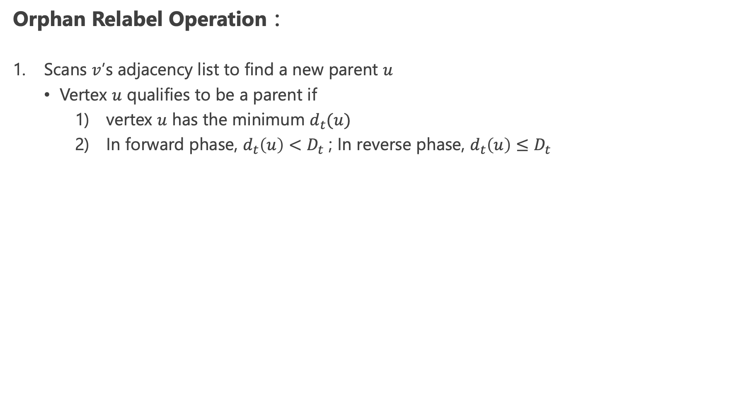
Orphan Relabel Operation (1/2)
Orphan Relabel Operation：
Scans $v$’s adjacency list to find a new parent $u$
Vertex $u$ qualifies to be a parent if
vertex $u$ has the minimum $d_{t}(u)$
In forward phase, $d_{t}\left(u\right)<D_{t}$ ; In reverse phase, $d_{t}\left(u\right)≤D_{t}$

Slide 15
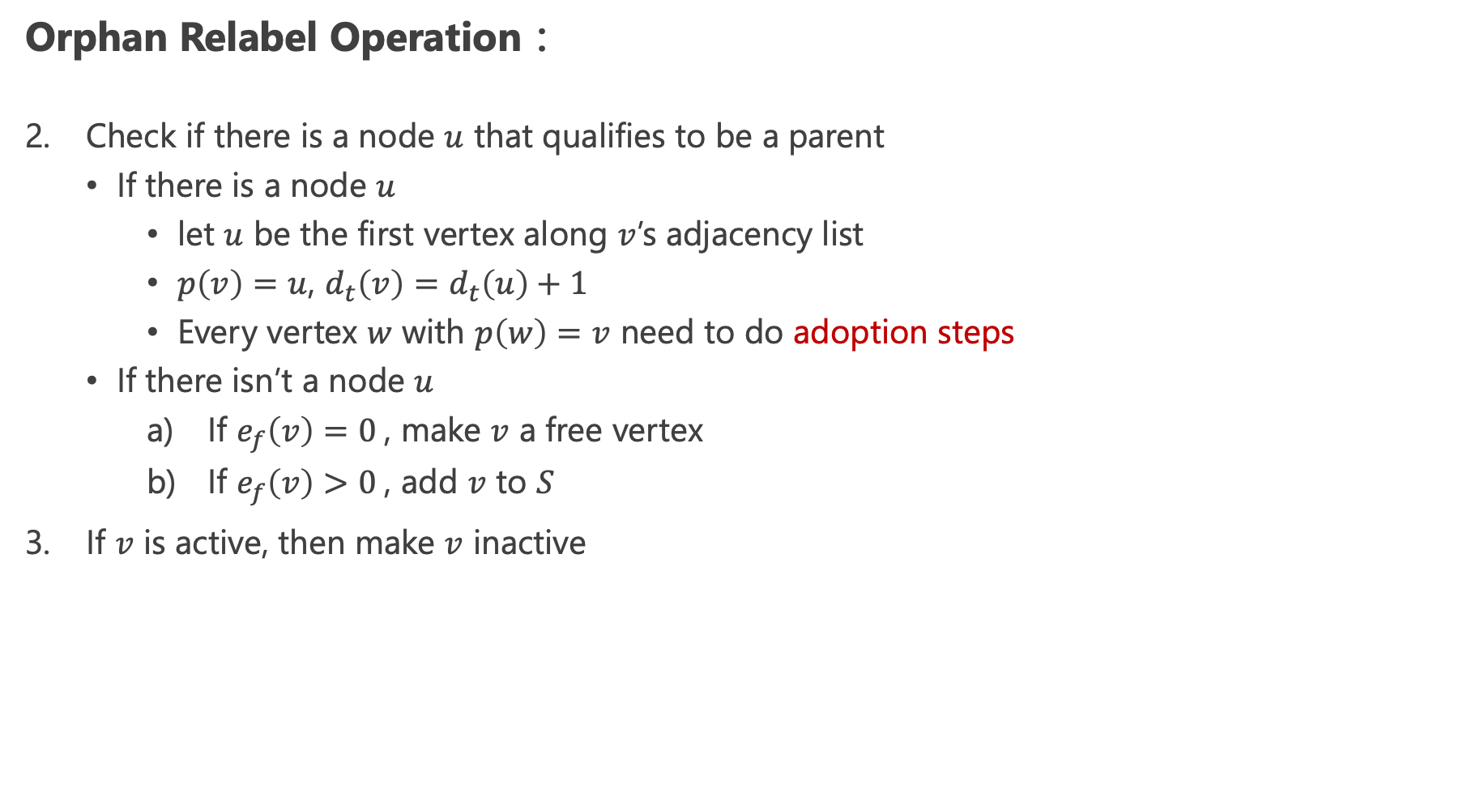
Orphan Relabel Operation (2/2)
Orphan Relabel Operation：
Check if there is a node $u$ that qualifies to be a parent
If there is a node $u$
let $u$ be the first vertex along $v$’s adjacency list
$p\left(v\right)=u$, $d_{t}\left(v\right)=d_{t}\left(u\right)+1$
Every vertex $w$ with $p\left(w\right)=v$ need to do adoption steps
If there isn’t a node $u$
If $e_{f}\left(v\right)=0$, make $v$ a free vertex
If $e_{f}\left(v\right)>0$, add $v$ to $S$
If $v$ is active, then make $v$ inactive

Slide 16
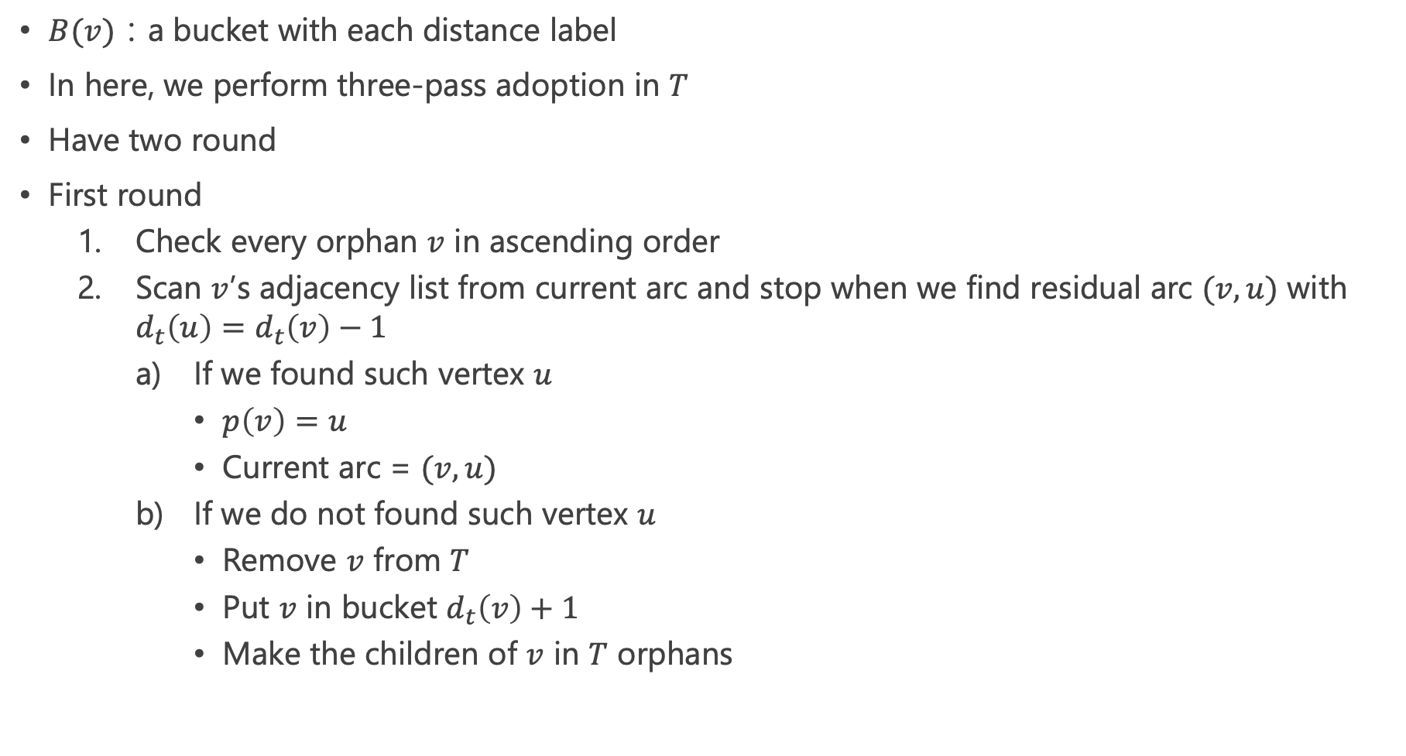
Adoption Steps：Three-Pass Adoption
$B(v)$：a bucket with each distance label
In here, we perform three-pass adoption in $T$
Have two round
First round
Check every orphan $v$ in ascending order
Scan $v$’s adjacency list from current arc and stop when we find residual arc $(v,u)$ with $d_{t}\left(u\right)=d_{t}\left(v\right)−1$
If we found such vertex $u$
$p\left(v\right)=u$
Current arc = $(v,u)$
If we do not found such vertex $u$
Remove $v$ from $T$
Put $v$ in bucket $d_{t}\left(v\right)+1$
Make the children of $v$ in $T$ orphans

Slide 17
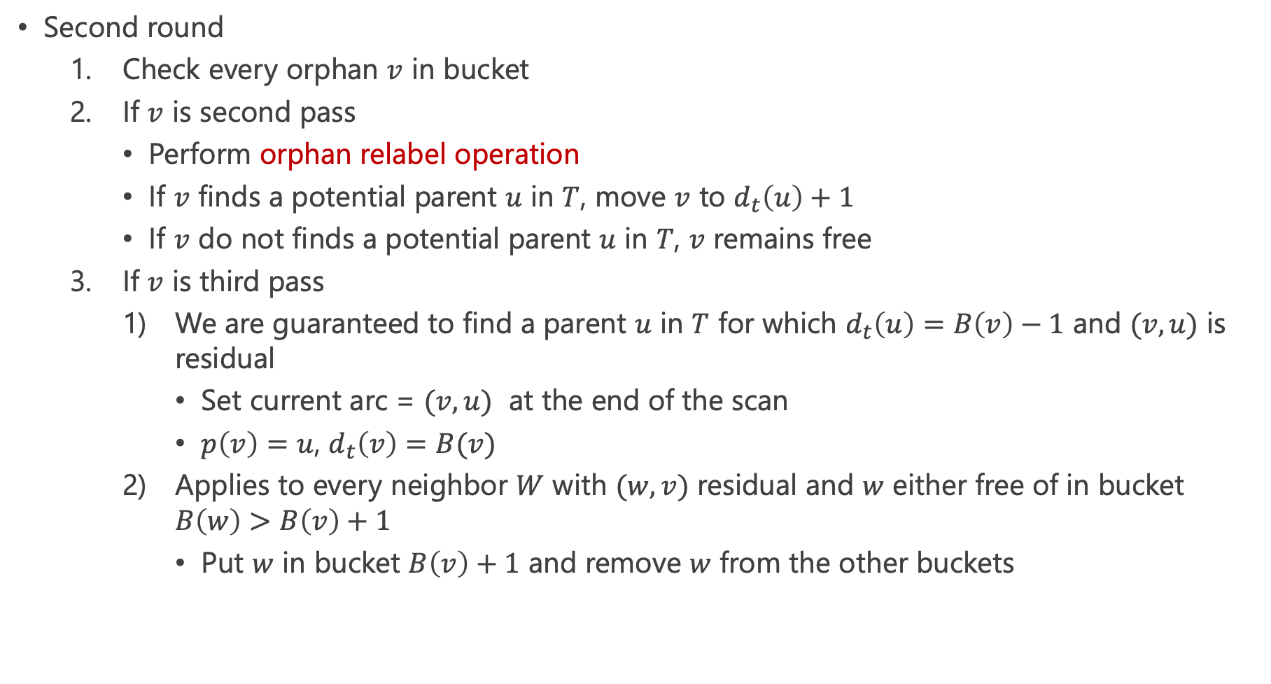
Adoption Steps：Three-Pass Adoption
Second round
Check every orphan $v$ in bucket
If $v$ is second pass
Perform orphan relabel operation
If $v$ finds a potential parent $u$ in $T$, move $v$ to $d_{t}\left(u\right)+1$
If $v$ do not finds a potential parent $u$ in $T$, $v$ remains free
If $v$ is third pass
We are guaranteed to find a parent $u$ in $T$ for which $d_{t}\left(u\right)=B\left(v\right)−1$ and $(v,u)$ is residual
Set current arc = $(v,u)$ at the end of the scan
$p\left(v\right)=u$, $d_{t}\left(v\right)=B(v)$
Applies to every neighbor $W$ with $(w,v)$ residual and $w$ either free of in bucket $B\left(w\right)>B\left(v\right)+1$
Put $w$ in bucket $B\left(v\right)+1$ and remove $w$ from the other buckets

Slide 18
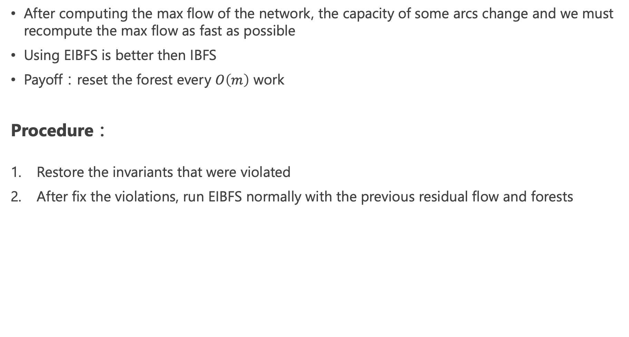
Dynamic Setting
After computing the max flow of the network, the capacity of some arcs change and we must recompute the max flow as fast as possible
Using EIBFS is better then IBFS
Payoff：reset the forest every $O\left(m\right)$ work
Procedure：
Restore the invariants that were violated
After fix the violations, run EIBFS normally with the previous residual flow and forests

Slide 19
Complexity of Excesses IBFS (1/5)
Same as IBFS
Three types of operations
Adoption steps
Growth steps with augmentations
Growth steps without augmentations

Slide 20
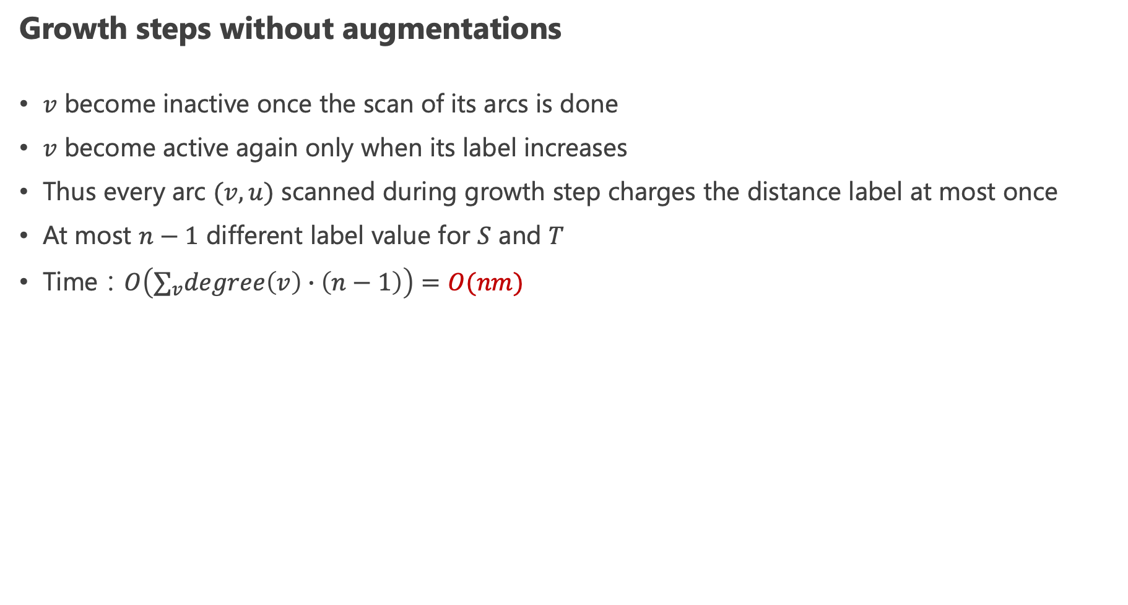
Complexity of Excesses IBFS (2/5)
Growth steps without augmentations
$v$ become inactive once the scan of its arcs is done
$v$ become active again only when its label increases
Thus every arc $(v,u)$ scanned during growth step charges the distance label at most once
At most $n−1$ different label value for $S$ and $T$
Time：$O\left(∑_{v}degree\left(v\right)∙\left(n−1\right)\right)=O(nm)$

Slide 21
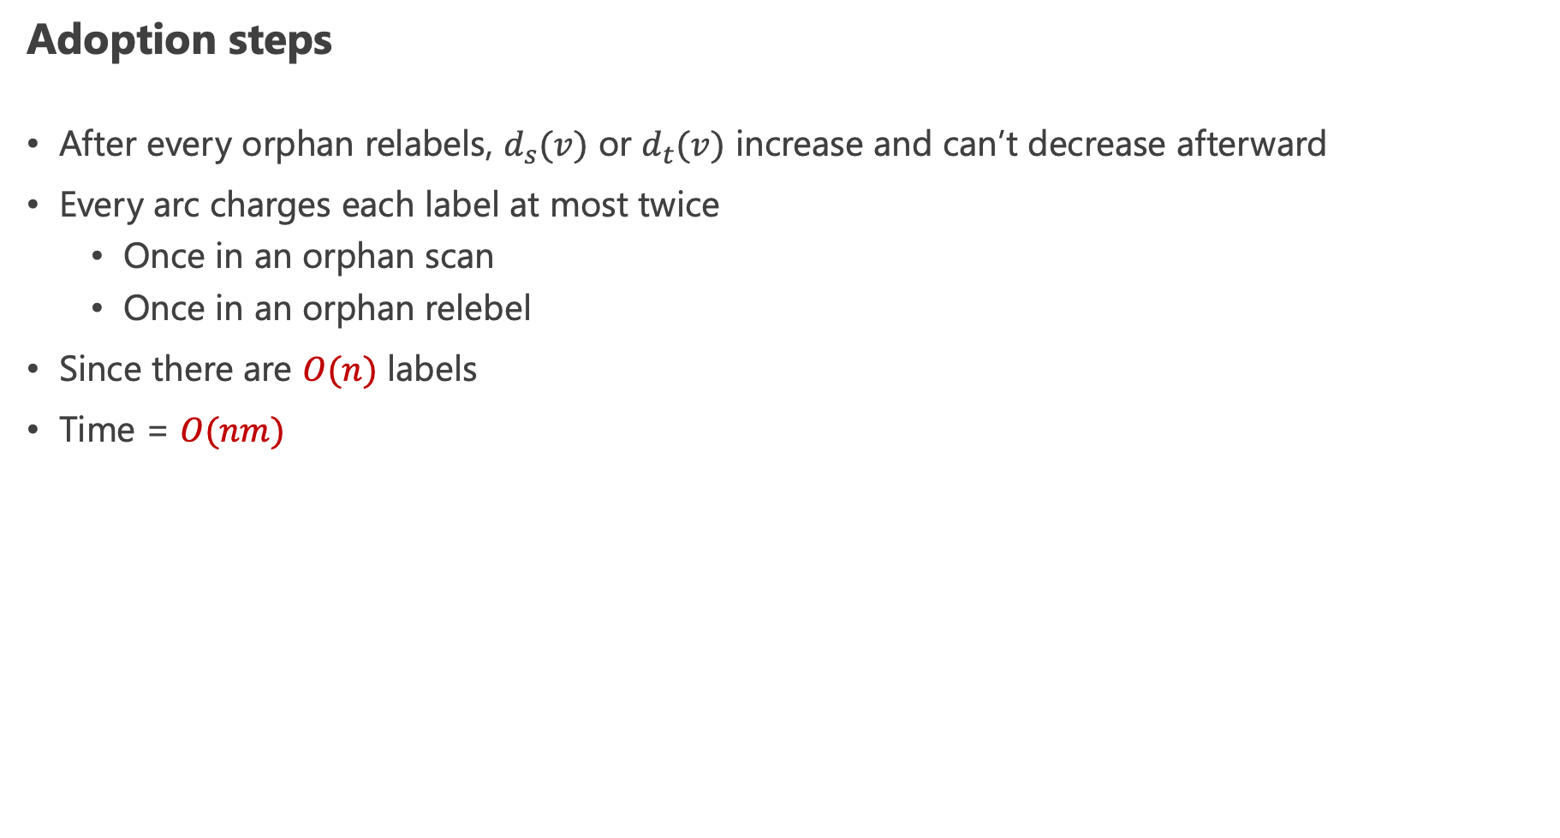
Complexity of Excesses IBFS (3/5)
Adoption steps
After every orphan relabels, $d_{s}(v)$ or $d_{t}(v)$ increase and can’t decrease afterward
Every arc charges each label at most twice
Once in an orphan scan
Once in an orphan relebel
Since there are $O(n)$ labels
Time = $O(nm)$

Slide 22
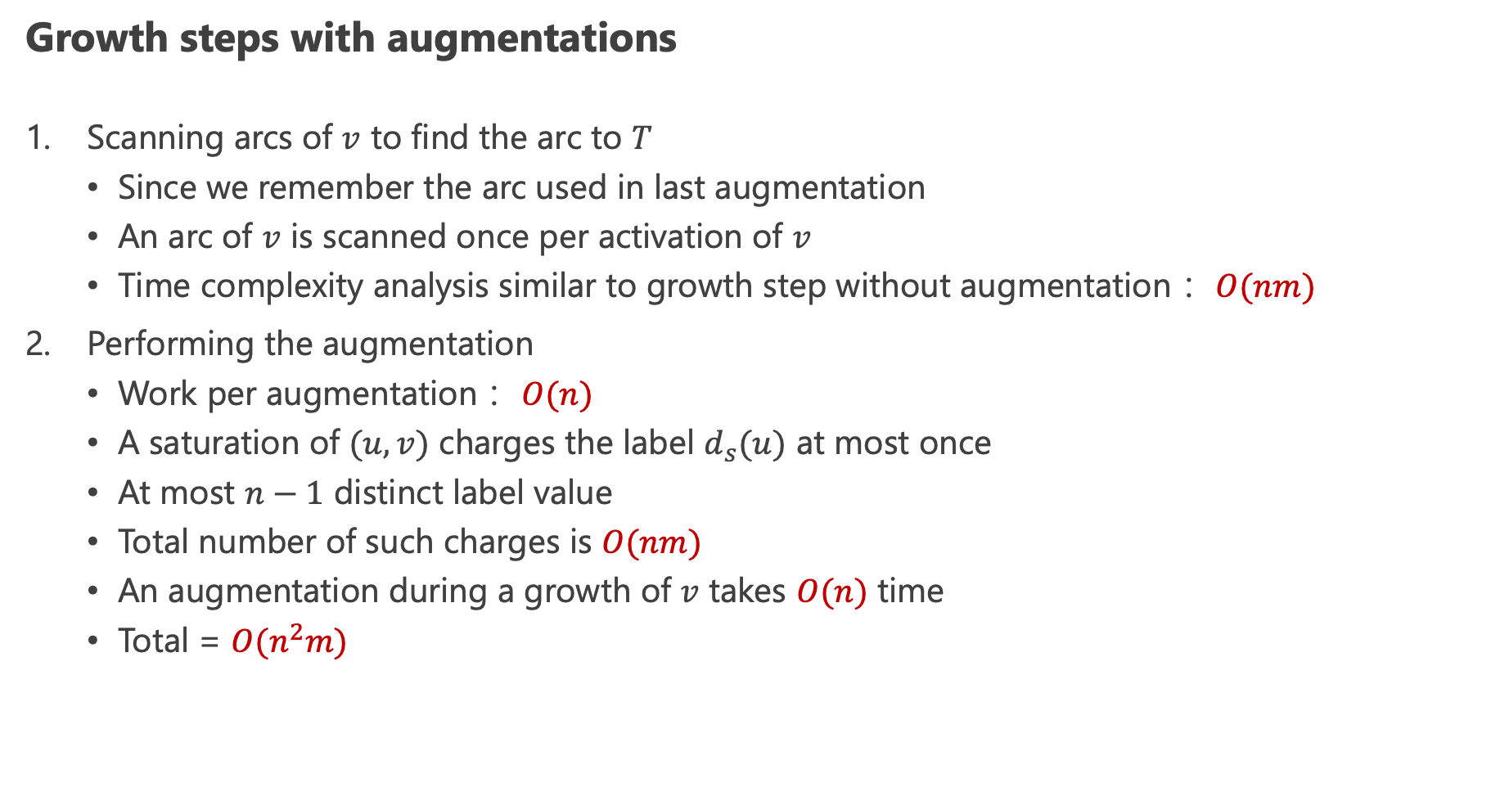
Complexity of Excesses IBFS (4/5)
Growth steps with augmentations
Scanning arcs of $v$ to find the arc to $T$
Since we remember the arc used in last augmentation
An arc of $v$ is scanned once per activation of $v$
Time complexity analysis similar to growth step without augmentation： $O(nm)$
Performing the augmentation
Work per augmentation： $O(n)$
A saturation of $(u,v)$ charges the label $d_{s}(u)$ at most once
At most $n−1$ distinct label value
Total number of such charges is $O(nm)$
An augmentation during a growth of $v$ takes $O(n)$ time
Total = $O(n^{2}m)$

Slide 23
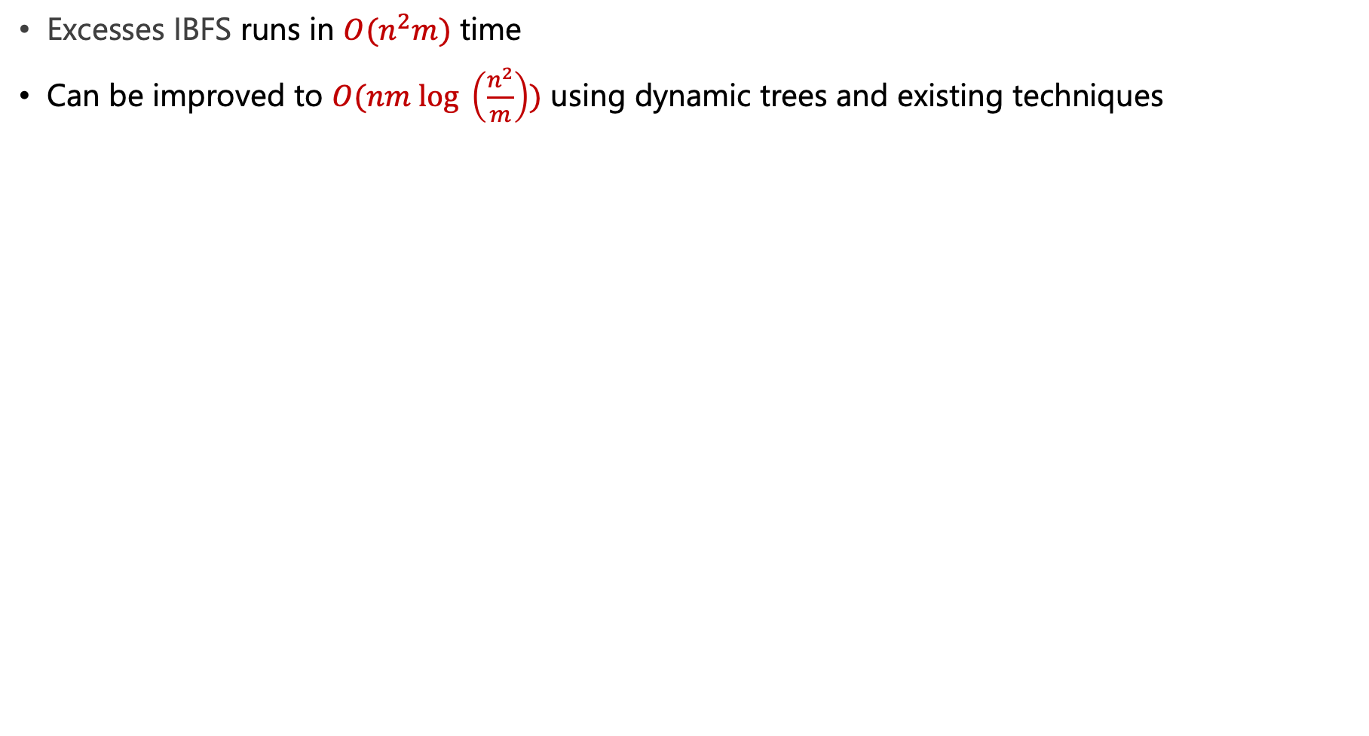
Complexity of Excesses IBFS (5/5)
Excesses IBFS runs in $O(n^{2}m)$ time
Can be improved to $O(nm log \left(\frac{n^{2}}{m}\right))$ using dynamic trees and existing techniques

Slide 24
Conclusion
EIBFS is a robust algorithm for the maximum flow problem that is suitable for dynamic application
On most instance, it is the fastest compared to all other algorithms
EIBFS is competitive in practice with the dynamic extension of BK
Compare to IBFS, EIBFS offers an faster and dynamic alternative to all existing methods

Slide 25
Thanks for Listening

